Slide 1
Visual Cryptography
By
A.Sravan (12N31A0501)
A.Hanuman (12N31A0519)
A.Phanisekhar Reddy(12N31A0520)
Sujith (12N31A0520)
Under the Guidance of
Mr. Kamal Sir

Slide 2
Contents
Abstract
Overview
Existing System
Proposed System
Advantages
Hardware and Software Specifications
UML Diagrams
Snapshots
Applications
Limitations
Enhancements
Conclusion
Bibliography

Slide 3
Abstract
Visual cryptography technique was proposed by Naor and Shamir in 1994.
Visual cryptography is one of the techniques used to encrypt the images by dividing the original image into transparencies.
The transparencies can be sent to intended person, and at the other end the transparencies received person can decrypt the transparencies using our tool, thus gets the original image.

Slide 4
Our Visual cryptography provides the demonstration to the users to show how encryption and decryption can be done to the images.
In this technology, the end user identifies an image, which is not the correct image.
That is, while transmitting the image the sender will encrypt the image using our application here sender gets two or more transparencies of the same image.
Our application provides an option to the end user of encryption.

Slide 5
Visual Cryptography is a secret-sharing method that encrypts a secret image into several shares but requires neither computer nor calculations to decrypt the secret image.
Instead, the secret image is reconstructed visually: simply by overlaying the encrypted shares the secret image becomes clearly visible
Using our application we can save encrypted images that are in the format of .gif and .png.
The saved encrypted transparencies can be sent to the intended person by means of mails/faxes.

Slide 6
  Plaintext (in form of image)
  Encryption (creating shares)
  Channel (Fax, Email)
  Decryption (Human Visual System)

Slide 7
Overview
In Fig A, the visual crypto example logo has been split into two shares.
Each white pixel in the original logo is split into two of the same small blocks that have half black and white pixels.
When these two blocks are overlaid, they align exactly, and so the result is a light-colored block (with half black and half white pixels).

Slide 8
Each black pixel in the original logo is split into two complementary small blocks.
When these two blocks are overlaid, the result is completely black block.
Individual shares reveal no information about the original image.

Slide 9



Layer 1 | Layer 2 | Overlay
Fig A:-Demonstration of visual cryptography

Slide 10
Each pixel of the image is divided into smaller blocks. There are always the same number of white (transparent) and black blocks.
If a pixel is divided into two parts, there are one white and one black block. If the pixel is divided into four equal parts, there are two white and two black blocks.
In the table on the right we can see that a pixel, divided into four parts

Slide 11
If the pixel of layer 2 is identical to layer 1, the overplayed pixel will be half black and half white. Such overplayed pixel is called grey or empty.
If the pixels of layer 1 and 2 are inverted or opposite, the overplayed version will be completely black. This is an information pixel.

Slide 12
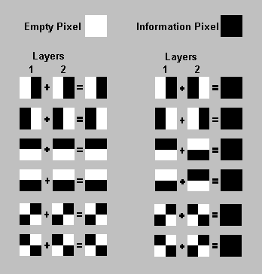
1-Black 0-White

Slide 13
Existing System
Visual cryptography is the art and science of encrypting the image in such a way that no-one apart from the sender and intended recipient even realizes the original image, a form of security through obscurity.
By contrast, cryptography obscures the original image, but it does not conceal the fact that it is not the actual image.
The existing system does not provide a friendly environment to encrypt or decrypt the data (images).

Slide 14
Proposed System
Proposed system Visual cryptography provides a friendly environment to deal with images.
Generally cryptography tools supports only one kind of image formats.
Our application supports .gif and .png (portable network graphics) formatted images and our application has been developed using swing and applet technologies, hence provides a friendly environment to users

Slide 15
Problem Definition:- When ever we transmit the data(image) in the network, any unauthenticated person can read our data(image).
In order to provide security to data(image) generally sender will encrypt the data(image) and send it the intended person and the receiver will decrypt the encrypted data(image) and uses it.

Slide 16
Advantages
Communication is done in secure way. Simple to implement
Simple decode operations such as addition, XOR and inversing can be done on ability- restricted machines
Easily decoded by human vision.
Less time and space are needed for transparencies transmission and storage.
The decryption process is very fast because it does not require neither calculations nor computer to decrypt secret shares.

Slide 17

Software and Hardware
Requirements
Software Requirements:
Software
Operating System: Windows XP, 7
Technologies: JAVA 6.0, Swing
Tools: Net Beans 6.0
Hardware
Processor: Intel or AMD processor
RAM: 256 MB or more
Hard Disk Space: 8 GB or more

Slide 18
UML Diagrams

Slide 19
Class Diagram

Slide 20
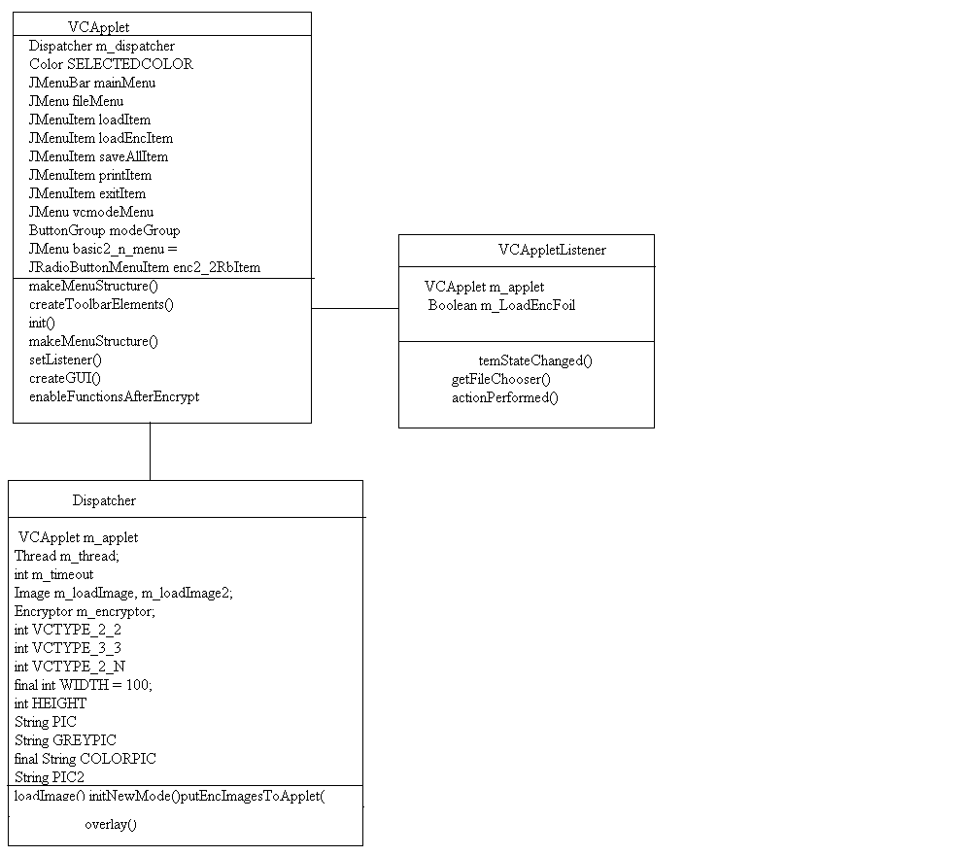

Slide 21
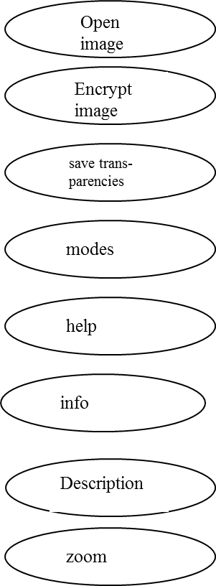
Subsystem decomposition
User

Slide 22
Snapshots

Slide 23
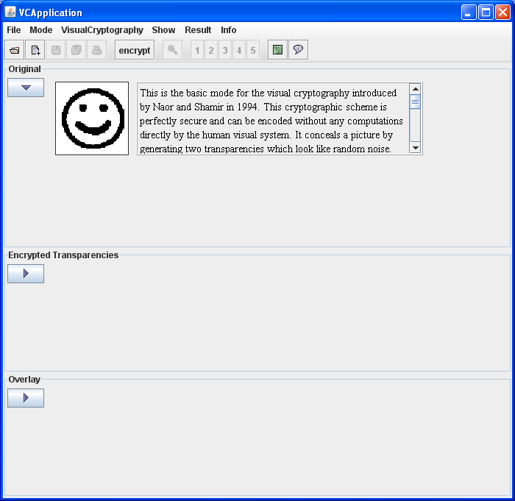

Slide 24
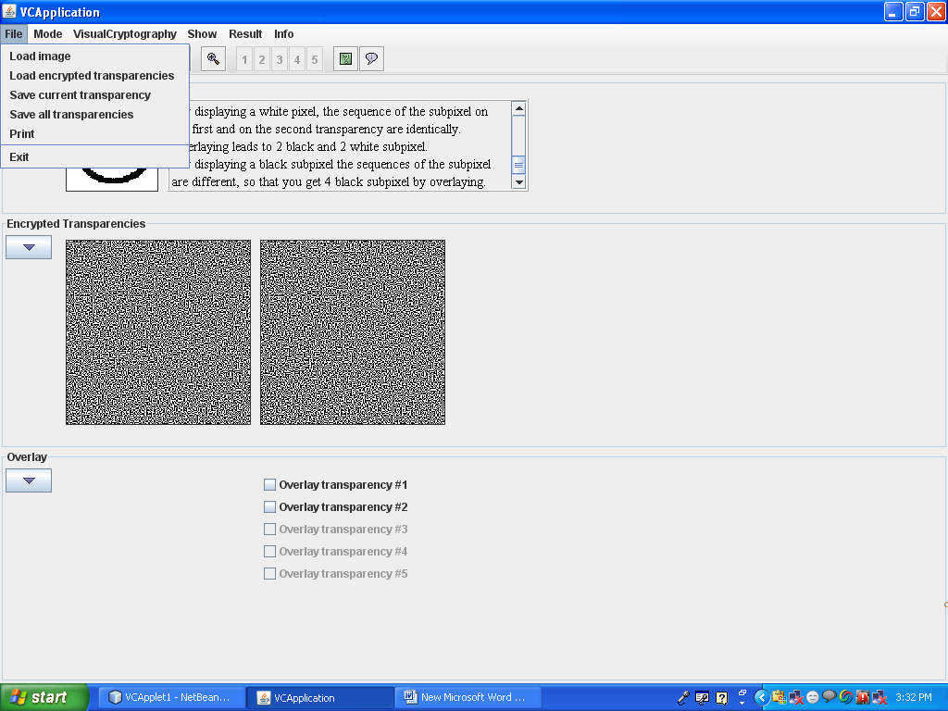

Slide 25
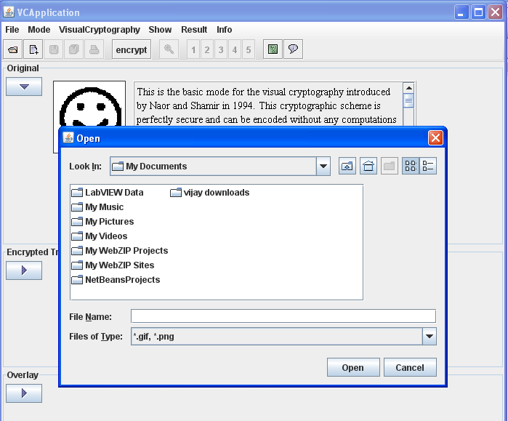

Slide 26
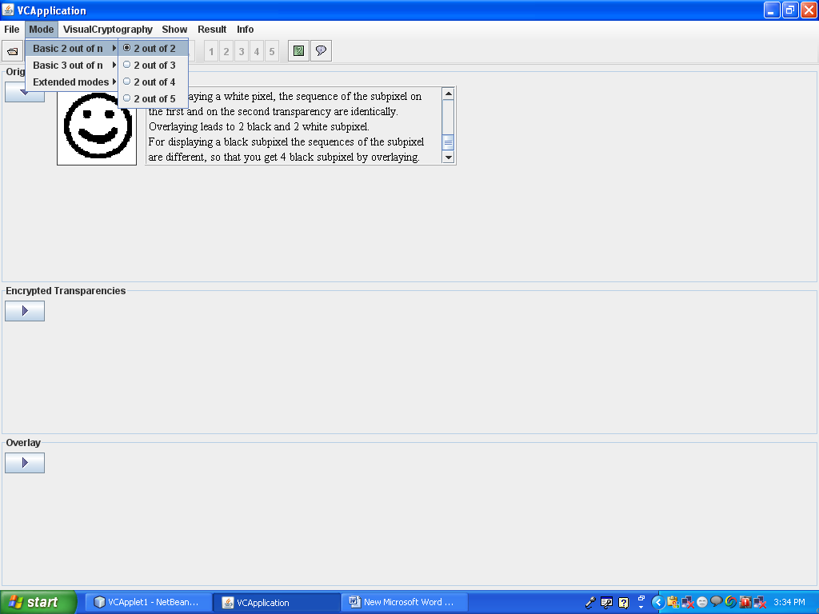

Slide 27
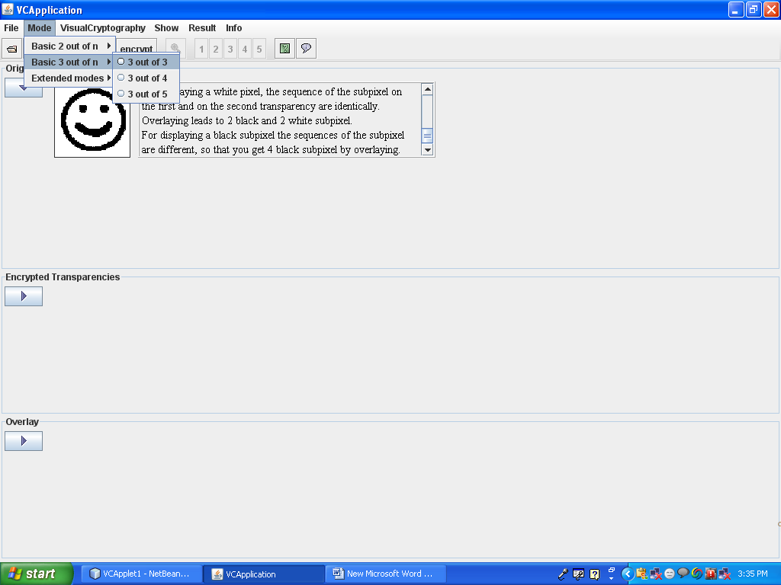

Slide 28
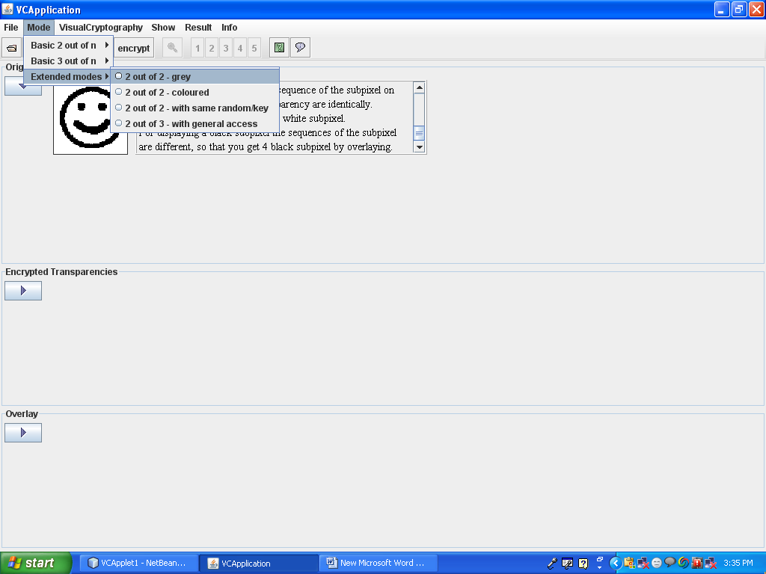

Slide 29
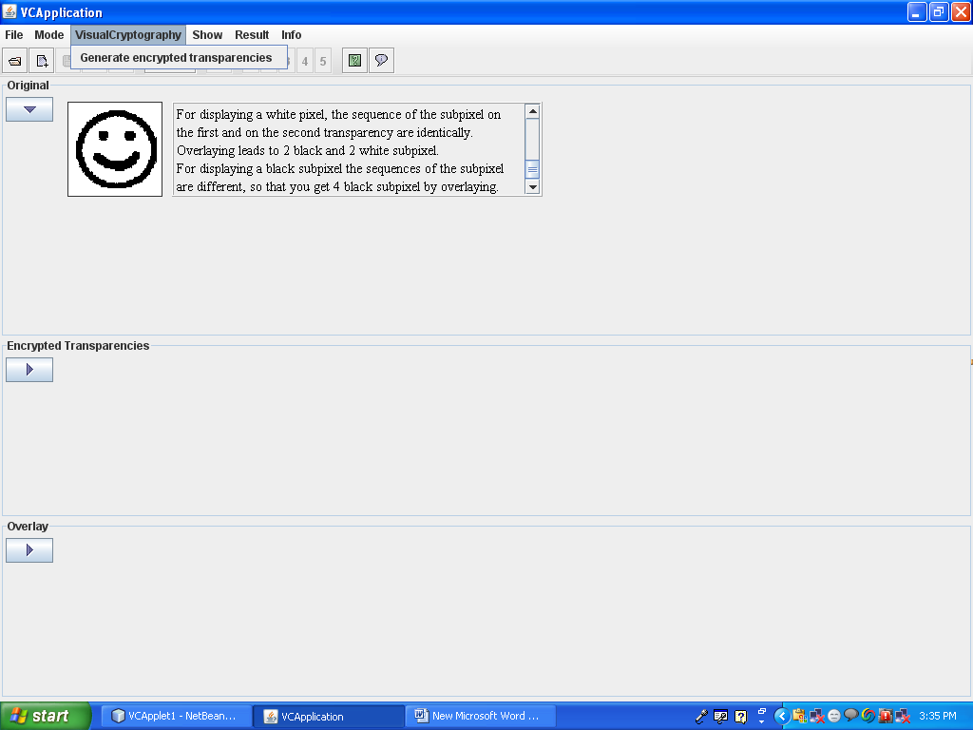

Slide 30
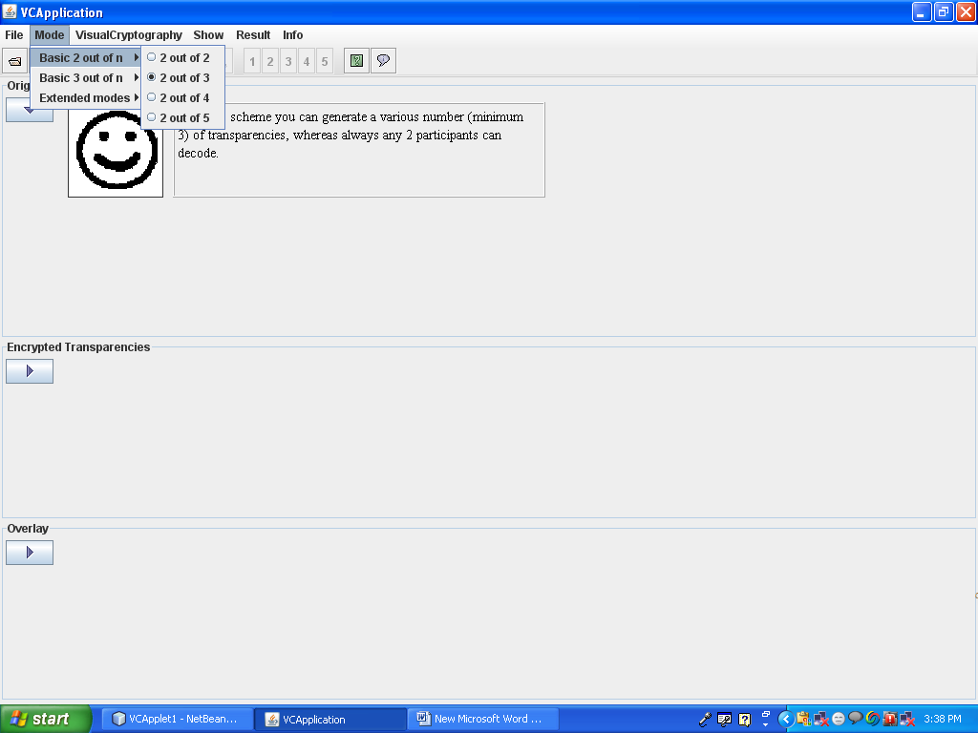

Slide 31
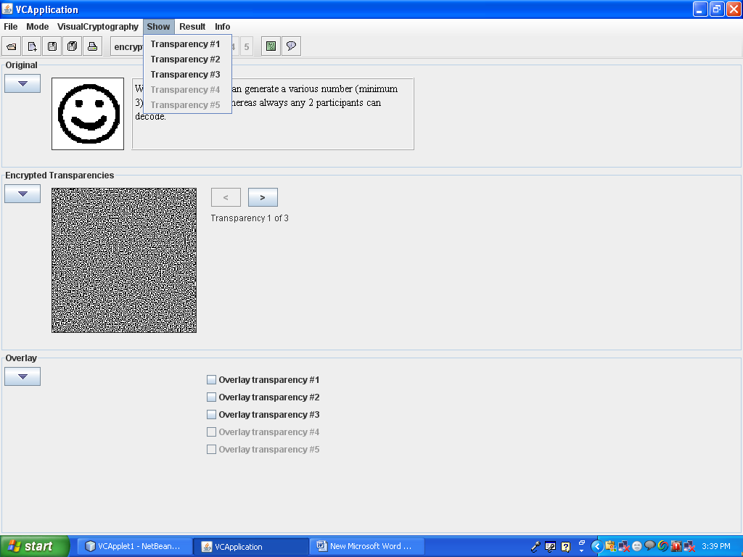

Slide 32
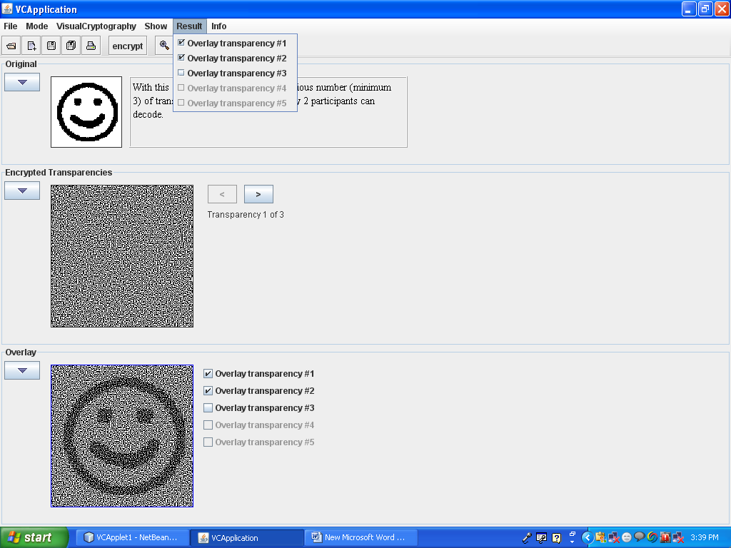

Slide 33
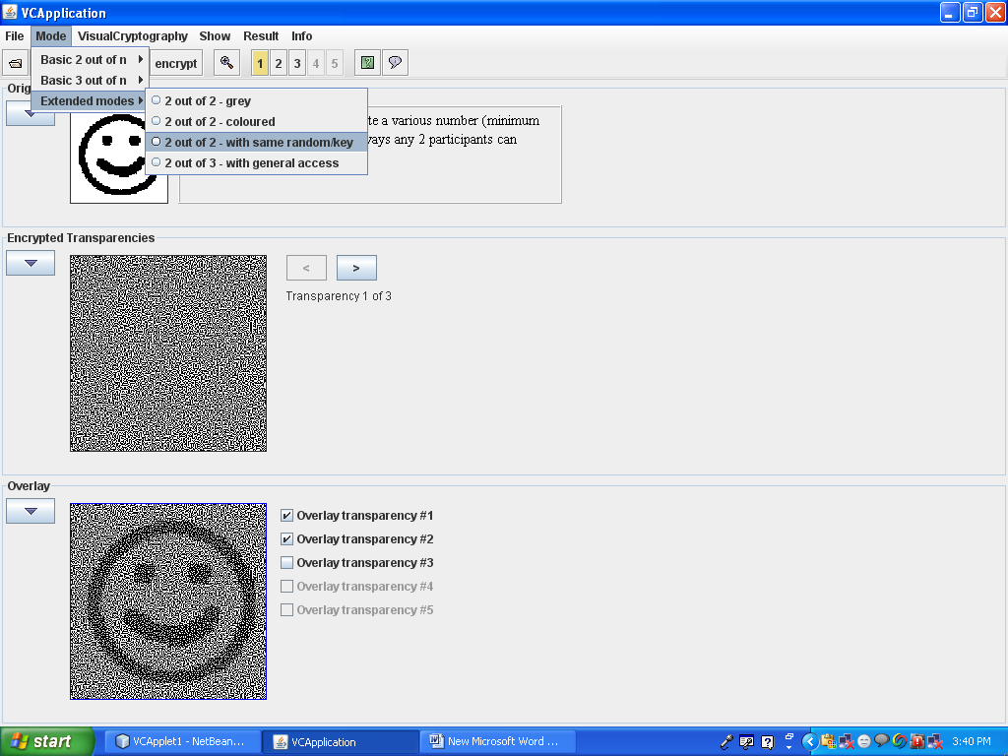

Slide 34
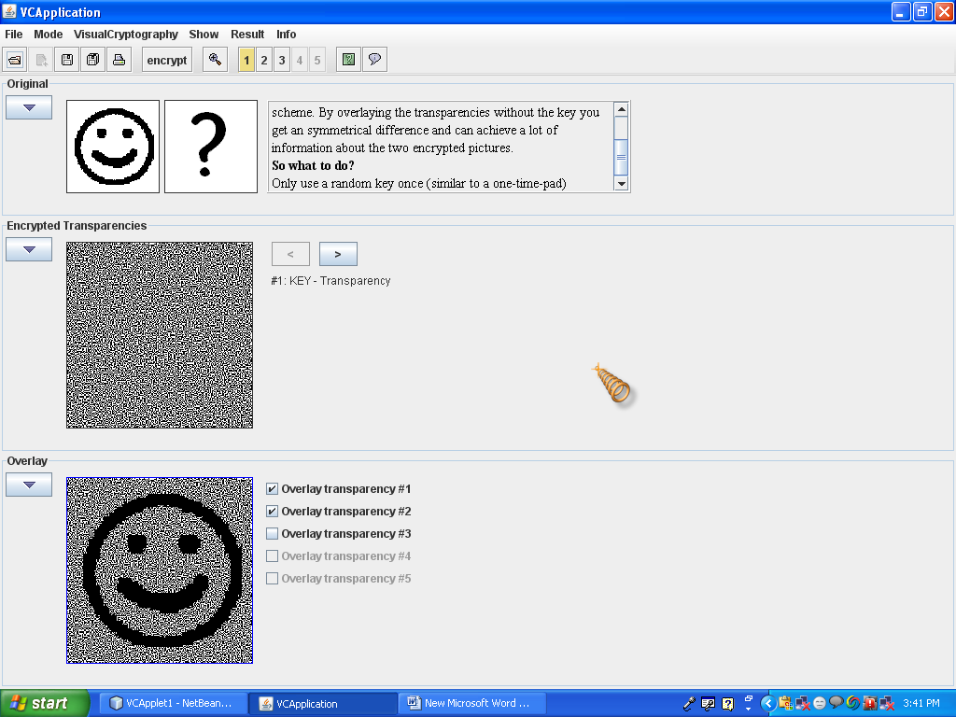

Slide 35
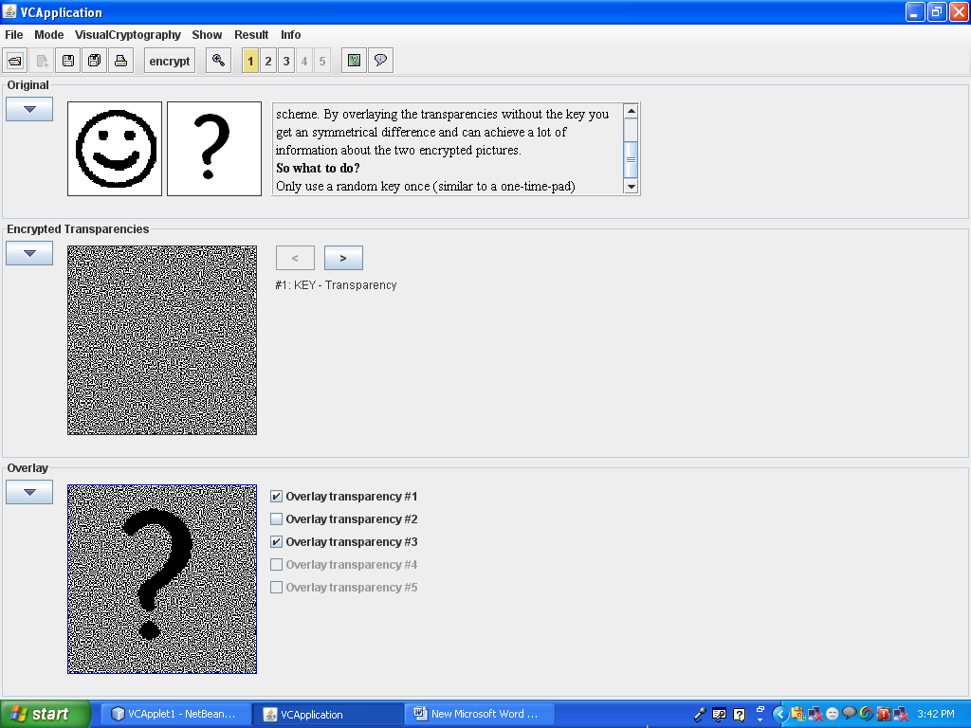

Slide 36
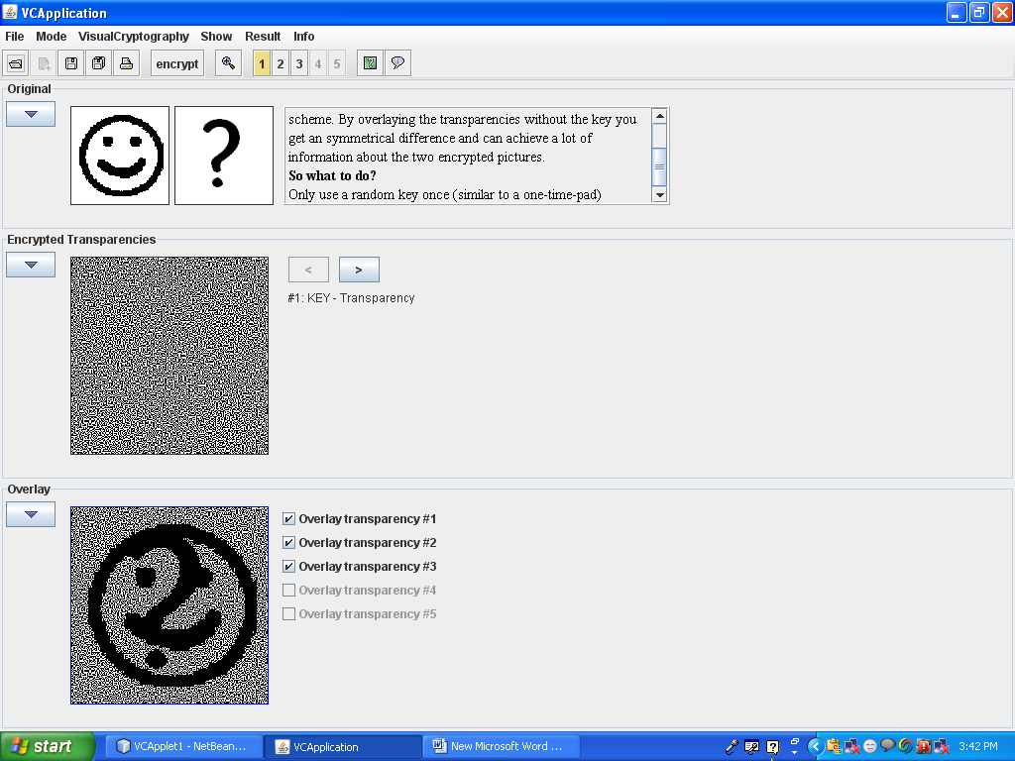

Slide 37
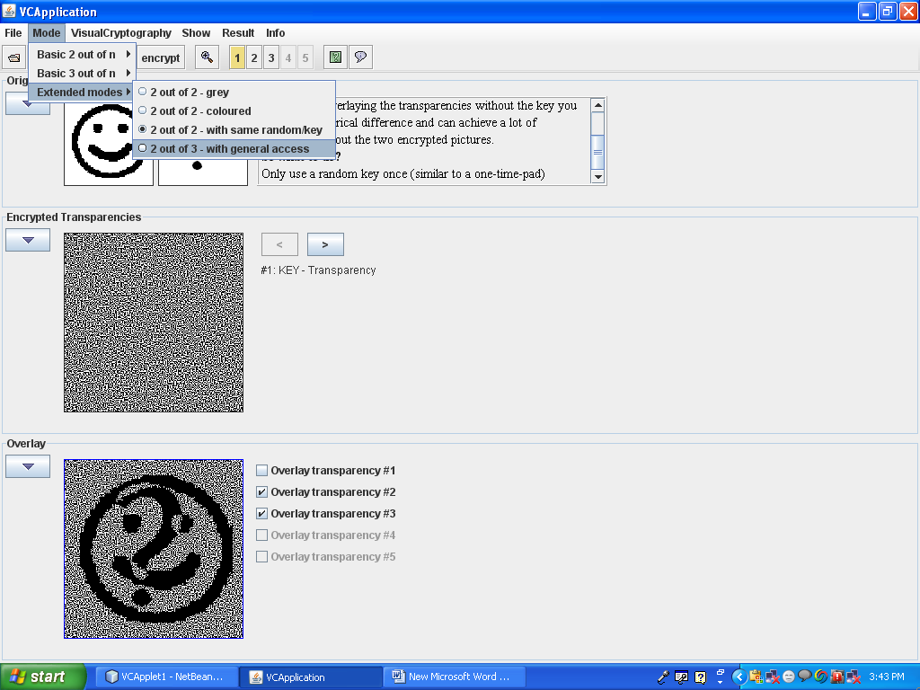

Slide 38
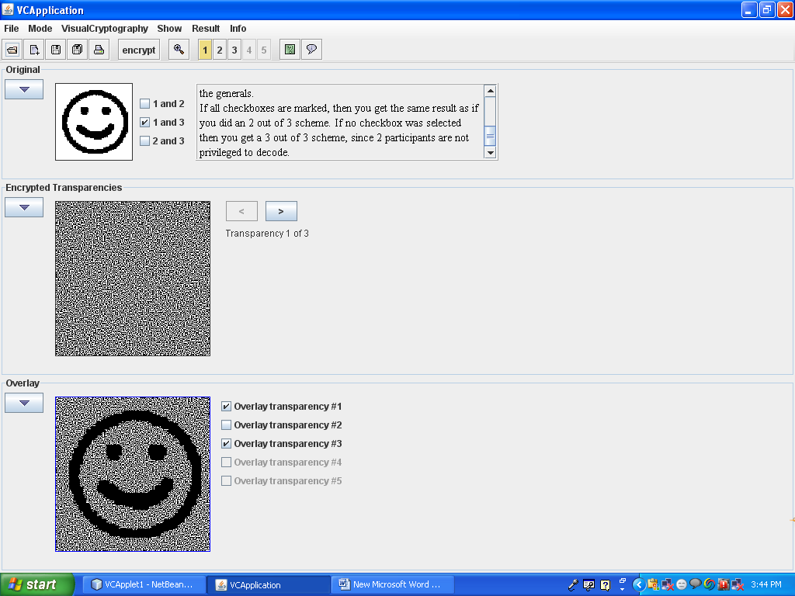

Slide 39
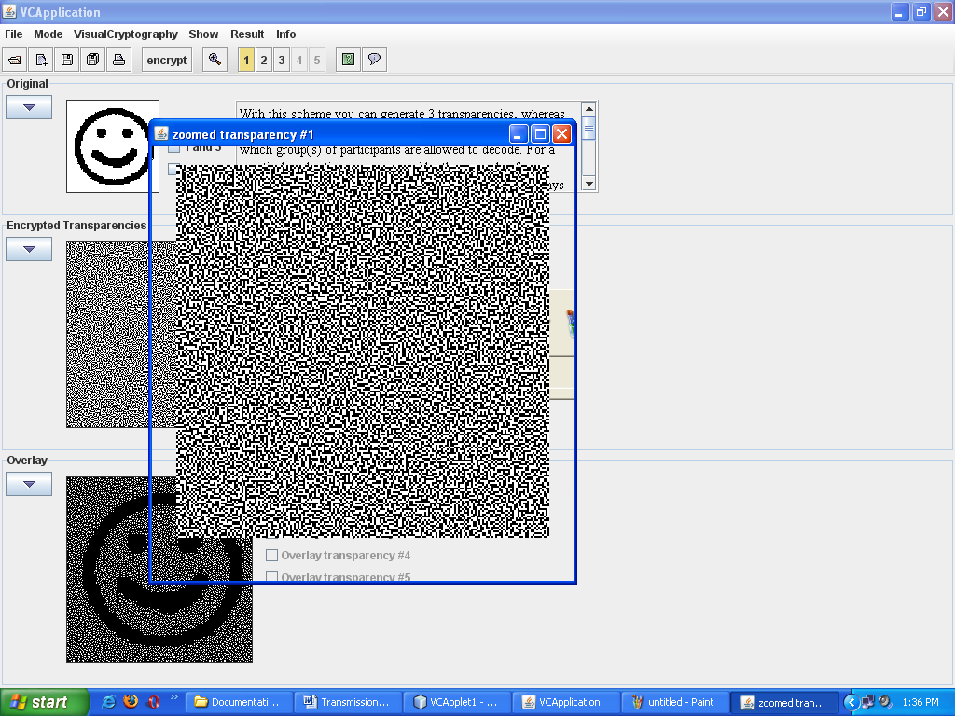

Slide 40
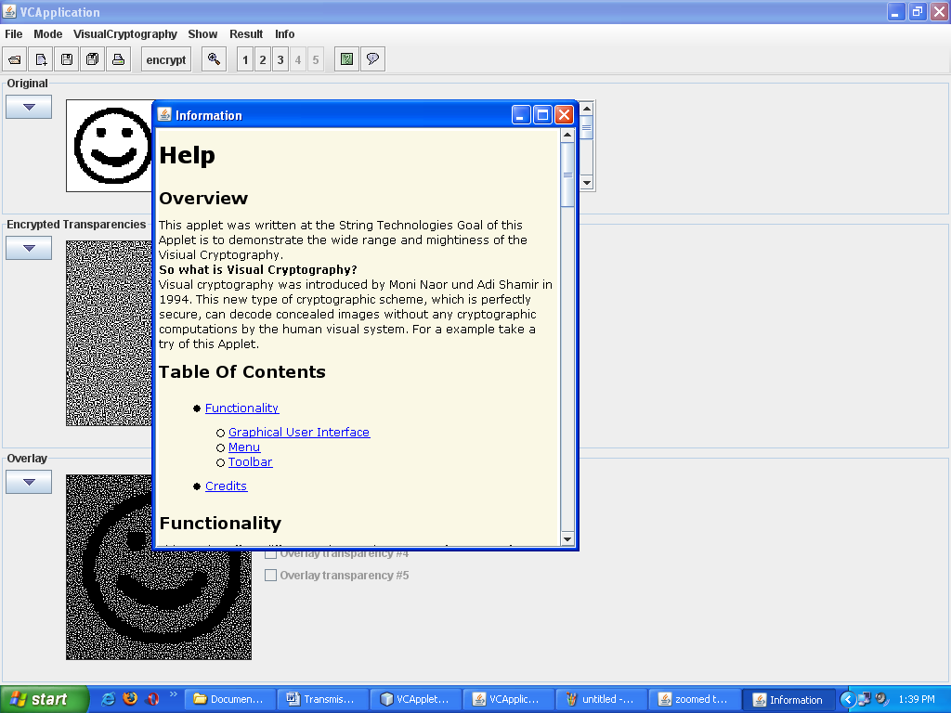

V

Slide 41
Applications
Visual Cryptography is mainly used by
Banks.
Government organizations.
Internet service companies.

Slide 42
Limitations
Position and time accuracy is required.
It supports only two types of formats like
.png and .gif.
Some formats are not supported by this tool like
.bmp and .jpeg.
Color images are not encrypted with this tool.

Slide 43
Enhancements
We want to survey visual cryptography schemes of gray scale and color images.
Extend the capability of our program such that it will be suitable for any kinds of input image.

Slide 44
Conclusion
The Proposed System provides a friendly environment to deal with images. Security is provided in the form obscurity. It supports .gif and .png formats. Our application has been developed using swing and applet technologies, hence provides a friendly environment to users.

Slide 45
Bibliography
The Complete Reference (Java) By Herbert Schildt
Gray Cornett, Horstmann, CorelJava, Sunsoft Press, 1996.
Patrick Naughton & Herbert Schildt, Java : The Complete Reference, Tata McGraw-Hill, Macrch 1997.
Grady Booch, Object Oriented Analysis and Design with Applications, the Benjimin/Cummings, 1994.

Slide 46
Thank You

